Slide 1


Cognitive Processing Systems of Enumeration
Paul Garrett & Ami Eidels
Enumeration: The process of quantifying a set of numerous items

Slide 2


The Question
Which Queue is Shortest?

Slide 3
Background
Processing System – Integrates processing channels
Enumeration – Application of a quantity to a set of numerous items.
Processes of Enumeration
-Subitizing
-Counting

Slide 4
Background
Subitizing | Counting
Items Less than Four | Items Greater than Four
Holistic (all at once) | Accumulative (one at a time)
Effortless | Resource demanding
For Example:
For Example:

Slide 5
Background – Processing Systems
Subitizing
Counting
Processing
System
Parallel
Serial

Slide 6
Background – Process Slopes

Slide 7
Background – Model Mimicry
Subitizing
Counting
Processing
System
Parallel
Serial

Slide 8
Systems Factorial Technology (SFT)
Sophisticated modeling technique utilizing response-time distributions (Townsend, 1990)
Immune to model mimicry

Slide 9
Systems Factorial Technology (SFT)
System Properties
1. System Architecture – Parallel vs. Serial
2. Stopping Rule – Self-Terminating vs. Exhaustive
3. Workload Capacity – Limited capacity
– Unlimited Capacity

Slide 10
Aim
To assess whether subitizing is an effortless process
To assess how systems of enumeration combine within the subitizing and counting ranges

Slide 11
Methodology

Slide 12
Does either display contain less
than three dots?

Slide 15
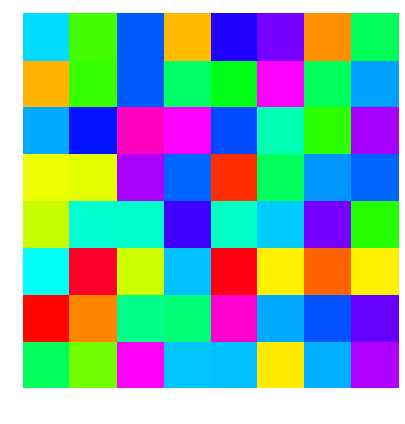
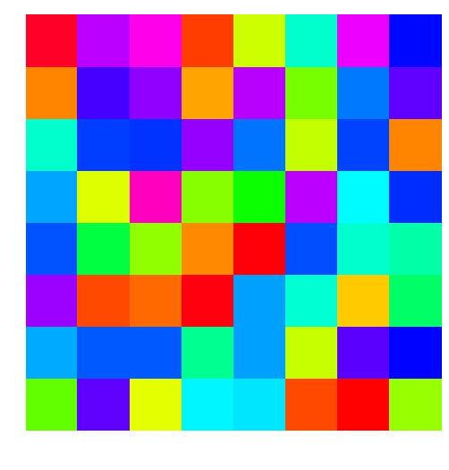

Slide 16
Yes
No
Yes
Z
/

Slide 17



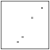


Methodology – Procedure
z
Trial n
Load
Target Present vs Absent
i.e. Either less than criterion
Salience
Numerical Distance Effect
i.e. Distance from criterion
Fixation Cross
(500ms)
RTI
(4000ms)
Stimulus Display
(500ms)
Post Stimulus Mask
(200ms)
Post Mask Blank
(3300ms)
ITI
(500ms)
Trial n + 1

Slide 18
Methodology – Procedure
z
Double Target
Load
Target Present vs Absent
i.e. Either less than criterion
Capacity
Coefficient ~ C(t)
Single Target

Slide 19
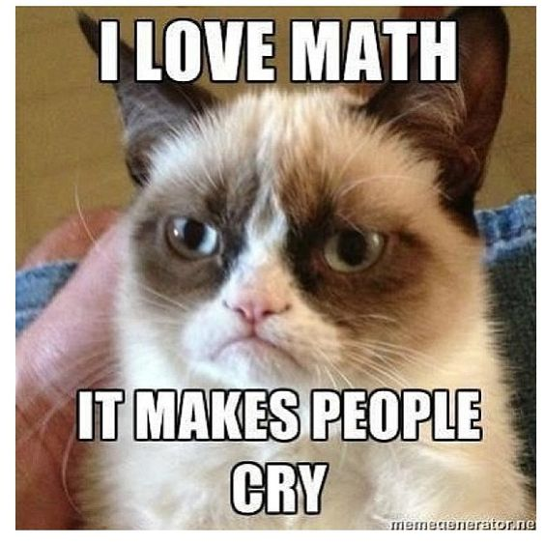
Methodology – Procedure
z
Double Target
Load
Target Present vs Absent
i.e. Either less than criterion
Capacity
Coefficient ~ C(t)
Single Target

Slide 20
Methodology – Procedure
z
Double Target
Load
Target Present vs Absent
i.e. Either less than criterion
Capacity
Coefficient ~ C(t)
C(t) < 1 Limited Capacity
C(t) = 1 Unlimited C.
Single Target

Slide 21
Methodology – Procedure
z
Numerical Distance Effect:
Closer item sets (i.e. 2 vs. criterion 3) are harder to compare than items further apart (i.e. 1 vs. criterion 3)
Salience
Numerical Distance Effect
i.e. Distance from criterion
Double Distractor
Double Target
Low
High
High
Low

Slide 22
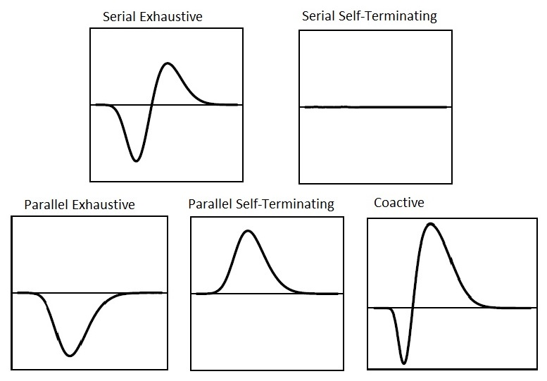
Methodology – Salience
Survivor Interaction Contrast (SIC) = HH – HL – LH – LL for AB and ∅∅ trials
Serial Exhaustive
Serial Self-Terminating
Parallel Exhaustive Parallel Self-Terminating
Parallel Exhaustive Parallel Self-Terminating Coactive

Slide 23
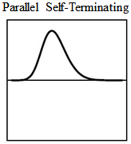
Methodology
Enumeration Process | Manipulation | Measure | Predicted | Outcome
Subitizing | Load | Capacity Coefficient | C(t) = 1 | ?
Subitizing | Salience (Target) | Survivor Interaction Contrast (SIC) |  | ?
Counting | Salience (Distractor) | SIC |  | ?

Slide 24
Methodology
Experiments:
Targets Criterion Distractors
Exp1: 1 2 3 4 5
1 2 3 4 5
Exp2: 2 3 4 5 6
Exp3: 3 4 5 6 7
Exp4: 4 5 6 7 8

Slide 25
Results
Experiment 1.1 – 1.4
500ms Display Time
Sub-experiments N = 10

Slide 26
Results – Capacity
Targets 1-2
Targets 2-3
Predicted Unlimited Capacity
C(t) = 1
Outcome: Limited Capacity
C(t) < 1
Subitizing is not effortless
Targets 3-4
Targets 4-5

Slide 27
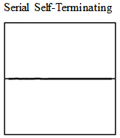
Results – Architecture
Targets 1-2
Targets 2-3
Predicted:
Targets 3-4
Targets 4-5
Outcome:

Slide 28
Results – Architecture
Distractors 4-5*
Distractors 5-6*
Predicted:
Distractors 6-7*
Distractors 7-8
Outcome:

Slide 29
Results – Architecture
Predicted:
Targets 4-5
Distractors 7-8
Outcome:
Also see...
Heathcote, Bushmakin & Eidels (submitted)

Slide 30
Background
Enumeration Process | Manipulation | Measure | Predicted | Outcome
Subitizing | Load | Capacity Coefficient C(t) | C(t) = 1 | C(t) < 1
Subitizing | Salience (Target) | Survivor Interaction Contrast
Counting | Salience (Distractor) | SIC

Slide 31
Results
Experiment 2.1 – 2.4
200ms Display Time
Sub-experiments N = 10

Slide 32
Results – Architecture
Targets 1-2*
Targets 2-3
Predicted:
Targets 3-4
Targets 4-5
Outcome:

Slide 33
Background
Enumeration Process | Manipulation | Measure | Predicted | Outcome
Subitizing | Load | Capacity Coefficient C(t) | C(t) = 1 | C(t) < 1
Subitizing | Salience (Target) | Survivor Interaction Contrast
Counting | Salience (Distractor) | SIC

Slide 34
Conclusion
First study to investigate systems of numerical cognition without the issue of Model Mimicry
Subitizing is not effortless, but a resource demanding process
Parallel subitizing is possible if the item sum is < 4
Stopping rule may change when capacity is severely limited

Slide 35



Future Research
Numerical SFT using coloured circles 1) Number 2) Number + Area 3) Number + Circumference
1)
2)
3)

Slide 36
Thankyou!

Slide 37

Acknowledgements
Thanks to the ARC who funded this research and my colleagues…
Philip Sewell
Abbie Hobson David Pearce

Slide 38
Questions?

Slide 39
Methodology – Double Factorial Design
Load
Factor A
Measure:
Capacity Coefficient ~ C(t)
C(t) < 1 Limited Capacity
C(t) = 1 Unlimited C.
C(t) > 1 Super Capacity
Target Presence
A-Target Left
B-Target Right
∅-Distractor
Combinations
AB, A∅, ∅B, ∅∅
Present
Absent
Present
AB
∅B
Factor B
Absent
A∅
∅∅

Slide 40
Methodology – Double Factorial Design
Measure:
Survivor Interaction Contrast (SIC)
Factor A
Salience
Present
Absent
Distance from
criterion
-High (H)
-Low (L)
Combinations
HH, HL, LH, LL
High Low High Low
HH
LH
HH
LH
Present
AB
∅B
HL
LL
HL
LL
Factor B
Low High Low High
HH
LH
HH
LH
Absent
A∅
∅∅
HL
LL
HL
LL

Slide 41
Methodology – Double Factorial Design
Load
Factor A
Salience
Target Presence
A-Target Left
B-Target Right
∅-Distractor
Combinations
AB, A∅, ∅B, ∅∅
Present
Absent
Distance from
criterion
-High (H)
-Low (L)
Combinations
HH, HL, LH, LL
High Low High Low
HH
LH
HH
LH
Present
AB
∅B
HL
LL
HL
LL
Factor B
Low High Low High
HH
LH
HH
LH
Absent
A∅
∅∅
HL
LL
HL
LL

Slide 42
Methodology – Double Factorial Design
Load
Target Criterion < 3 Dots
Salience
Factor A
Target Presence
A-Target Left
B-Target Right
∅-Distractor
Combinations
AB, A∅, B∅, ∅∅
Present
Absent
High Low High Low
High Salience
Target
1 =
1,1
1,2
5,1
4,1
Present
AB
∅B
Low Salience
Target
2,1
2,2
5,2
4,2
2 =
Factor B
Low High Low High
1,5
2,5
5,5
4,5
Low Salience
Distractor
4 =
Absent
A∅
∅∅
1,4
2,4
5,4
4,4
High Salience
Distractor
5 =

Slide 43
Methodology – Salience
z
Target Criteria: Are Either Less than Three?
Double Target Condition
High
High
High
Low
Low
High
Low
Low

